Slide 1
The Mysterious
Giant of Barletta
An Italian folktale
adapted and
illustrated by
Tomie DePaola

Slide 2
Genre: Folktale
A folktale is a type of incredible story
that traditionally was passed down
orally, not written down.
Something that is incredible is
amazing, unbelievable, or not likely to happen.
This story is from an old oral tradition
adapted by the author.

Slide 3
Meet the Author and Illustrator
By the age of four, Tomie dePaola knew what he
wanted to be when he grew up: an artist and
writer. (He also wanted to be a singer and tap
dancer!) His parents bought his art supplies and
let him work in a special space in the attic. Now
Tomie dePaola works in a very old barn at his
home in New Hampshire. At different times,
Tomie dePaola has designed posters, greeting
cards, and stage sets. He painted church murals
and taught art, too. Now, though, he writes and
illustrates children's books and paints pictures for
galleries. His dream, he says, is that at least one
of his books or pictures "will touch the heart of
some individual child and change that child's life
for the better.“

Slide 4
Summary
The town of Barletta faces destruction
until Zia Concetta asks the town’s giant
statue for help. With a clever idea, help
from the townspeople, and an onion,
the giant outwits the army and restores peace.

Slide 5
Background Information
Barletta is a city in Italy. The statue in
the story is a real statue that still stands
there today.

Slide 6
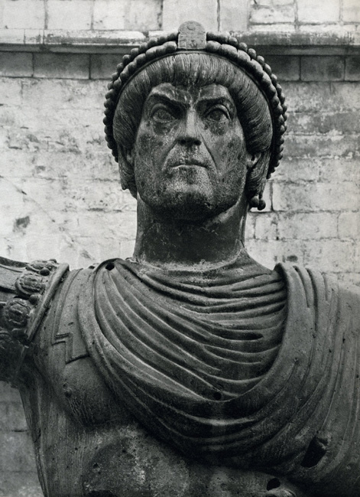
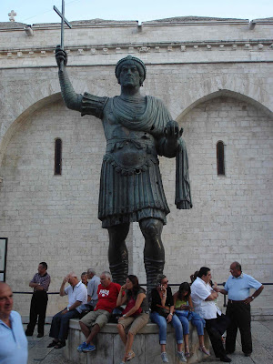
Colossus of Barletta
Giant of Barletta

Slide 7
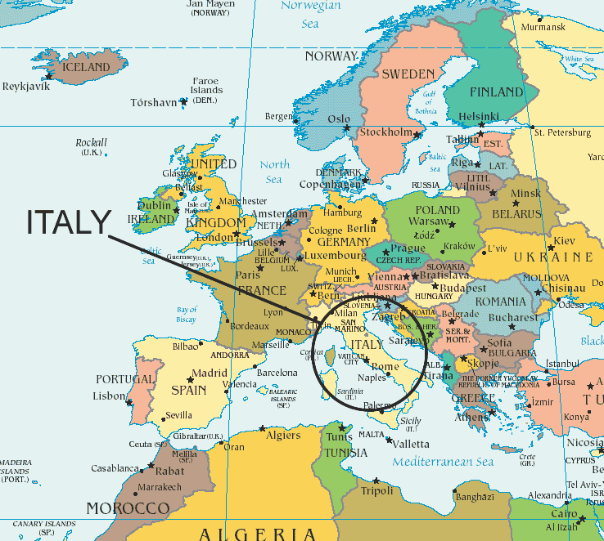
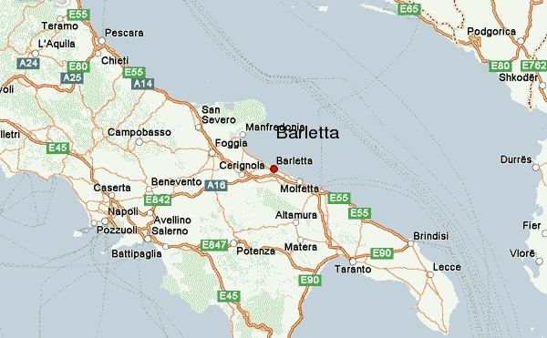
Location: Barletta, Italy
The Colossus of Barletta is a large bronze statue of an Eastern Roman Emperor, nearly three times life size (5.11 meters, or about 16 feet 7 inches) and currently located in Barletta, Italy.

Slide 8
The statue reportedly washed up on a shore, after a Venetian ship sank.
The statue evidently imitates an emperor, identifiable from his commanding gesture that looks like he is in the act of delivering a speech, with his right arm raised, holding a cross.

Slide 9
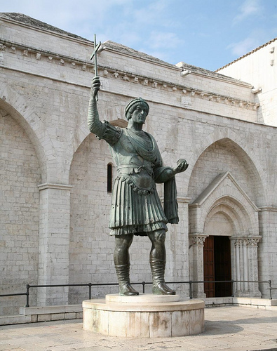
The Emperor wears a cuirass over his short tunic (shirt/dress).
His cloak is draped over his left arm in a portrait convention that goes back to Augustus.
In his outstretched left hand he now holds an orb.
His head wears a Gothic jewel, similar to the one worn by Aelia Eudoxia, mother of Theodosius

Slide 10
Key Vocabulary
giant
mysterious
pedestal
square
statue
weakling

Slide 11
giant
a huge, strong, imaginary creature that
looks like a human

Slide 12
mysterious
very hard to explain or understand

Slide 13
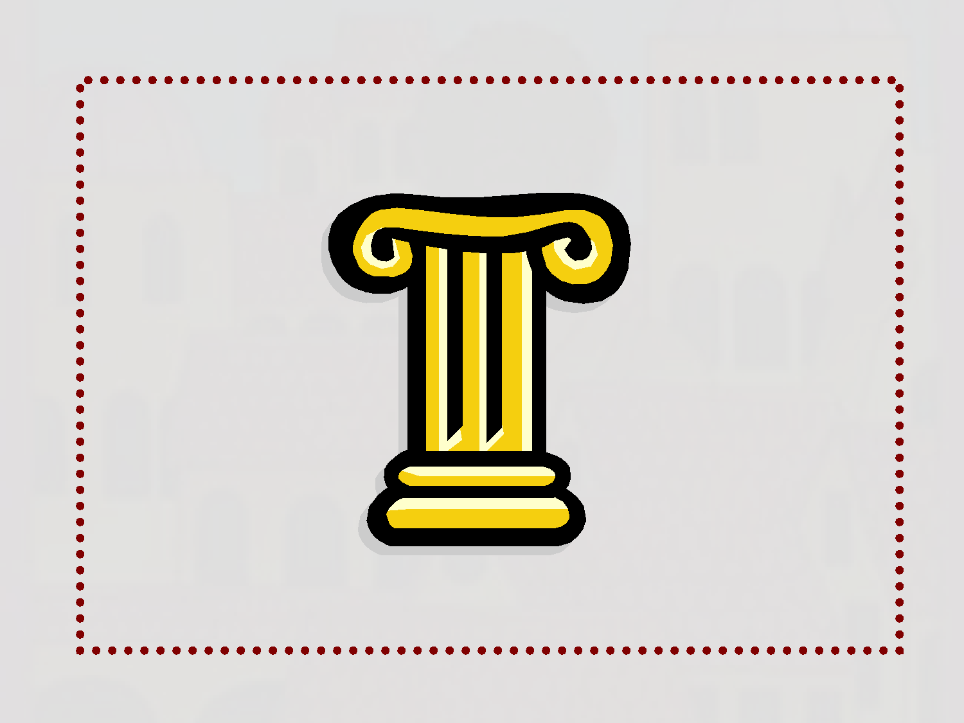
pedestal
the base on which a statue stands

Slide 14
square
an open area in the center of town

Slide 15
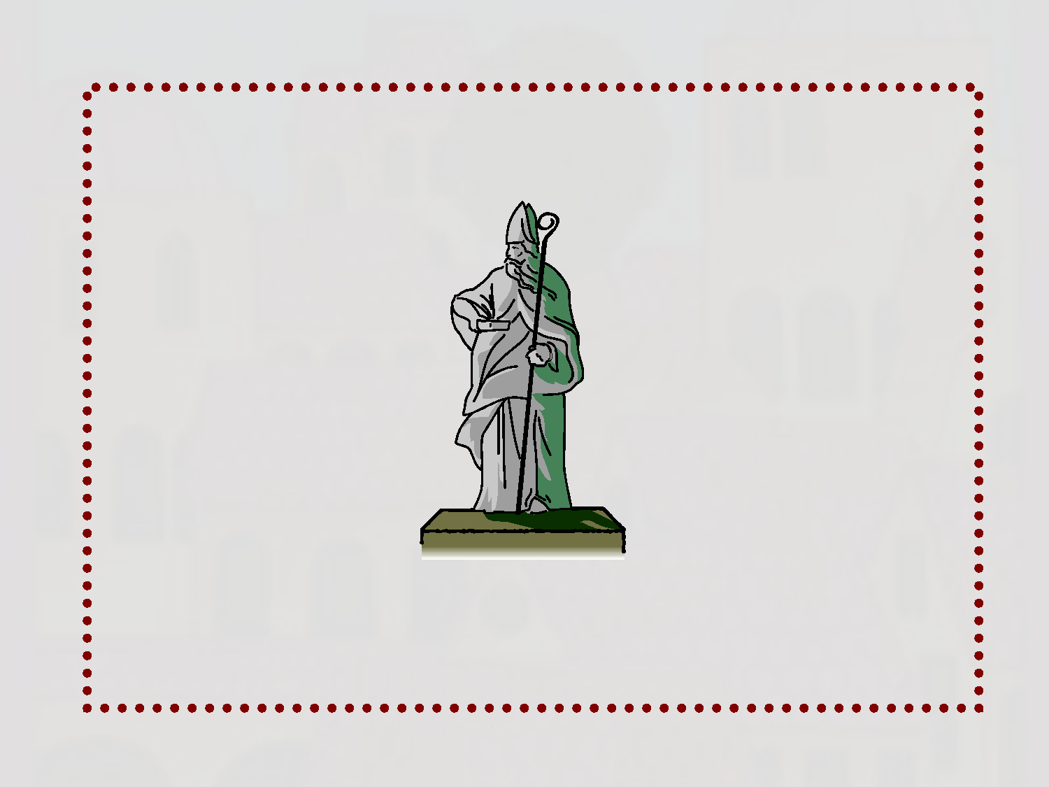
statue
an image, often of a person or animal,
usually made of stone, metal, or wood

Slide 16
weakling
a person lacking in power or strength

Slide 17
VOCABULARY REVIEW
giant - a huge, strong, imaginary creature
that looks like a human
mysterious - very hard to explain or understand
pedestal - the base on which a statue stands
square - an open area in the center of town
statue - an image, often of a person or animal, usually
made of stone, metal, or wood
weakling - a person lacking in power or strength

Slide 18
Strategy Focus: Question
We question to help us understand
what we see and/or read.
As you read about Barletta and the
giant, think of questions about:
– the town
– its people
– and the strange things that happen there.

Slide 19
Let’s try it!
Questions…
Where does the Mysterious Giant stand? (p 295)
How does the Giant use an onion
to help save the town? (p 304-306)

Slide 20
When all the townspeople get ready to
run from Barletta, why is Zia Concetta
the only one who doesn’t panic?
**Why do you think the Mysterious Giant decides to help Zia Concetta and the town?
**Why does Zia Concetta ask the
townspeople to stay out of sight?
**What might have happened if they hadn’t followed her orders?

Slide 21
Why is it better for the Giant to trick the
soldiers rather than to fight them?
If the Mysterious Giant came to your town,
what could he help the people do?
Suppose the Big Cheese from Mousopolis
were in charge of saving Barletta. **What might his plan have been?

