Slide 1
Brought to us by THE CUP ABOVE
Owl Project

Slide 2
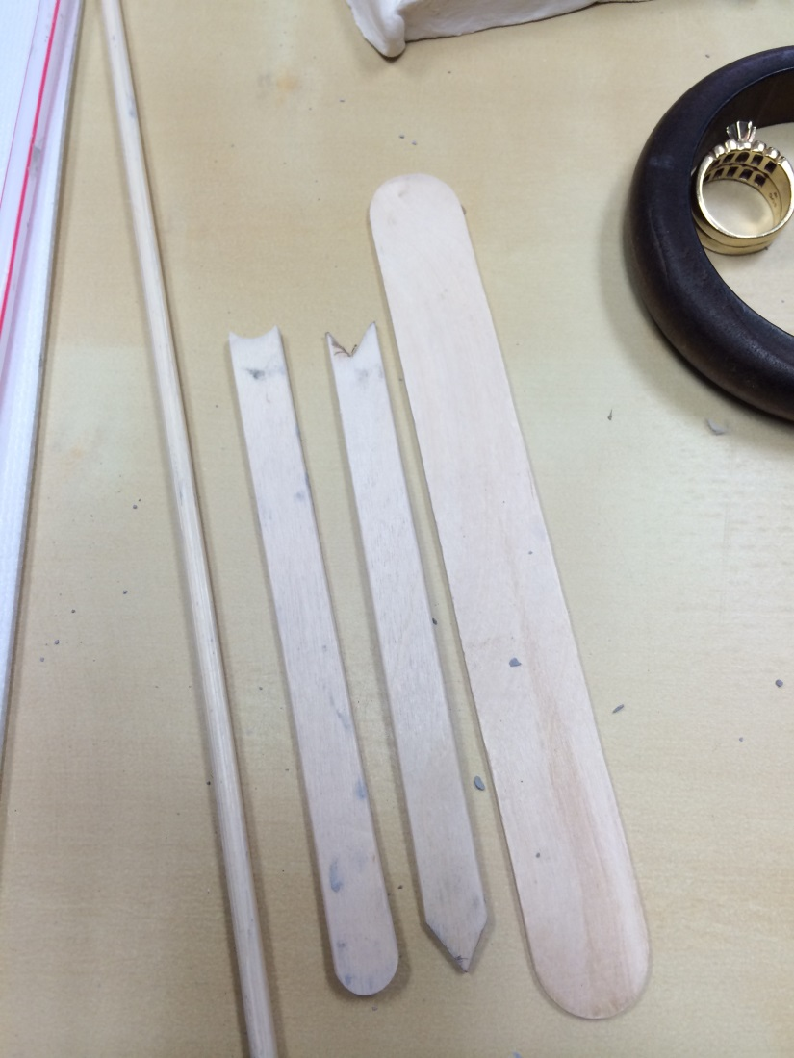
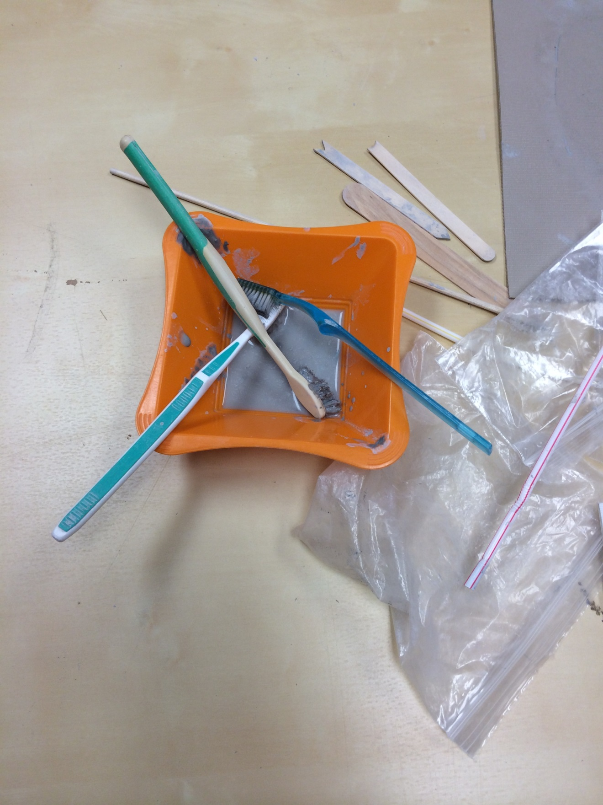
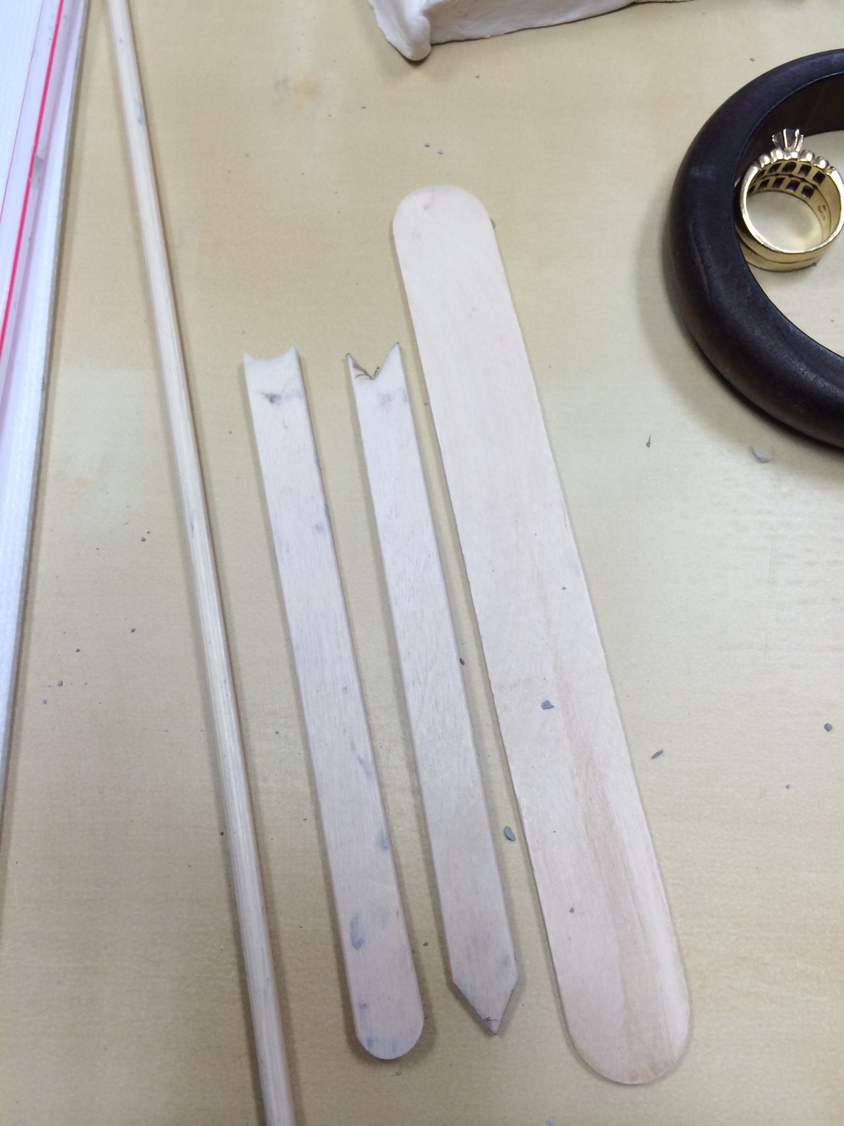
Designing Tools

Slide 3
Tools to help clay stick together

Slide 4
Shape it into a flat circle

Slide 5
Folding your clay to create your Owl

Slide 6
Shape your owl.

Slide 7
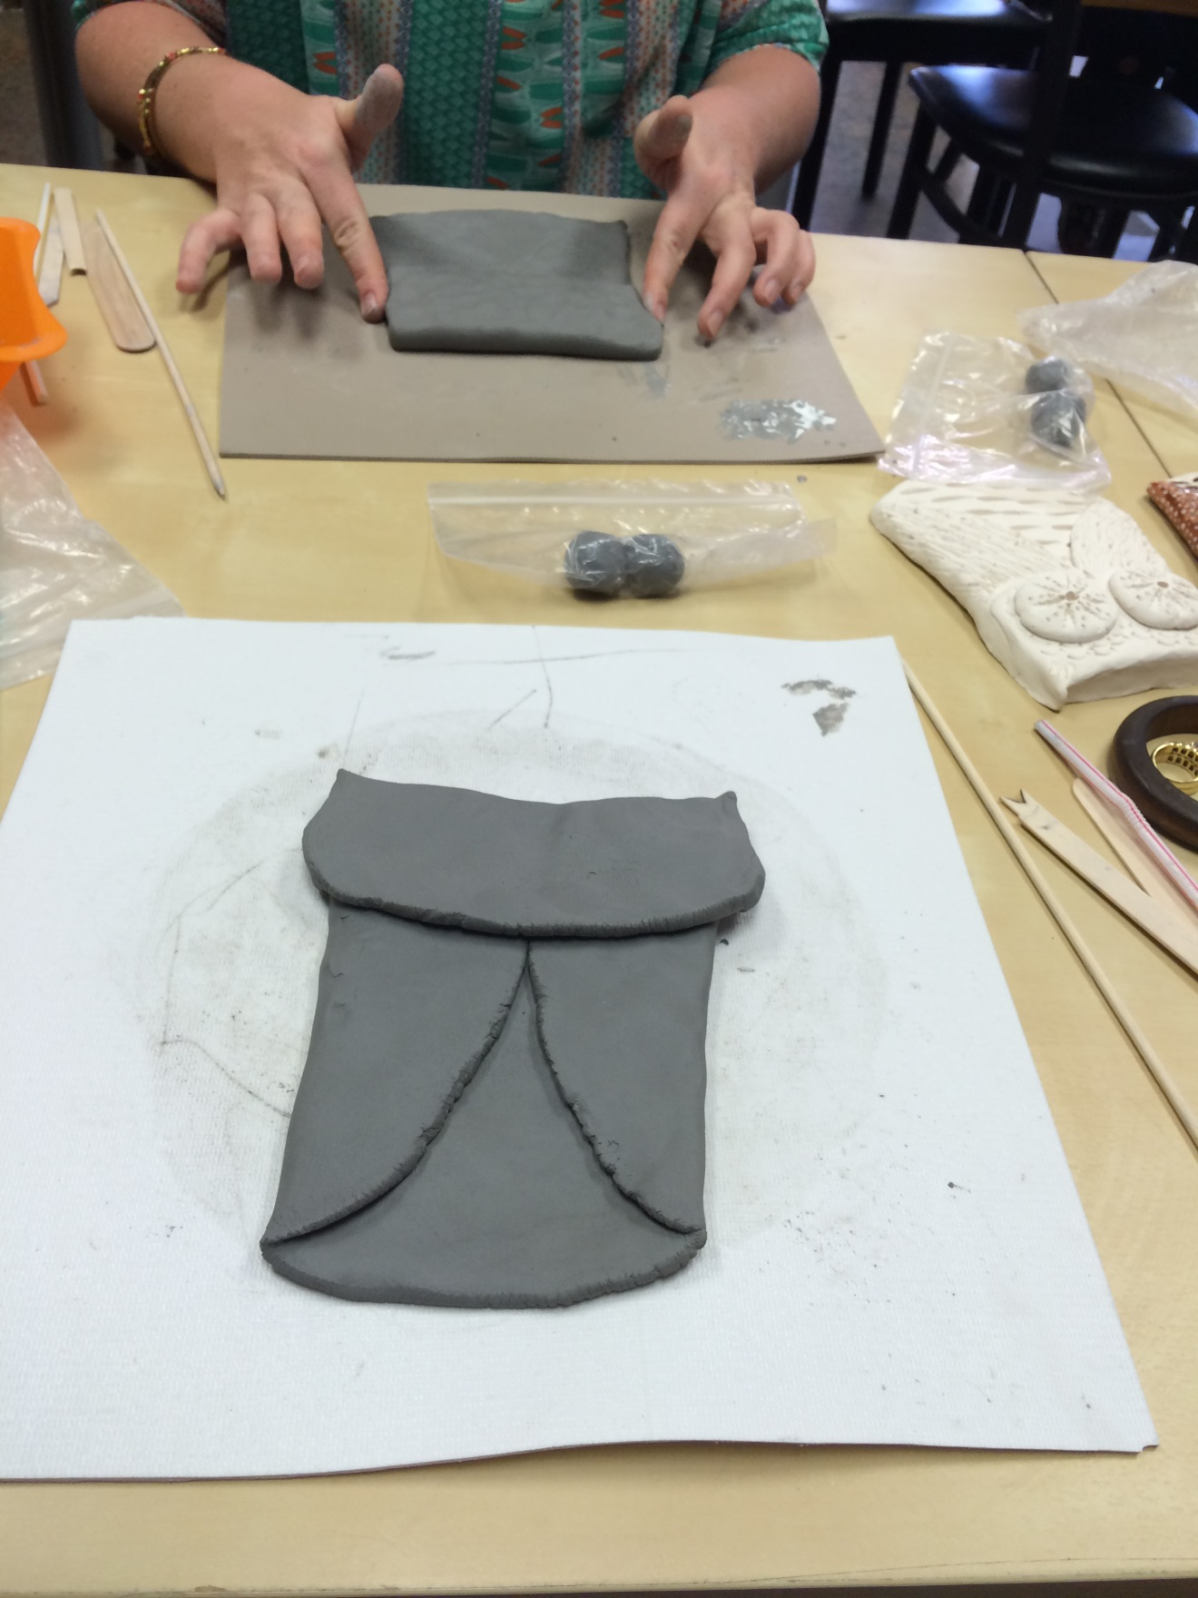
Folds create the base. Then pinch the ears.

Slide 8
Flatten the Clay for eyes

Slide 9
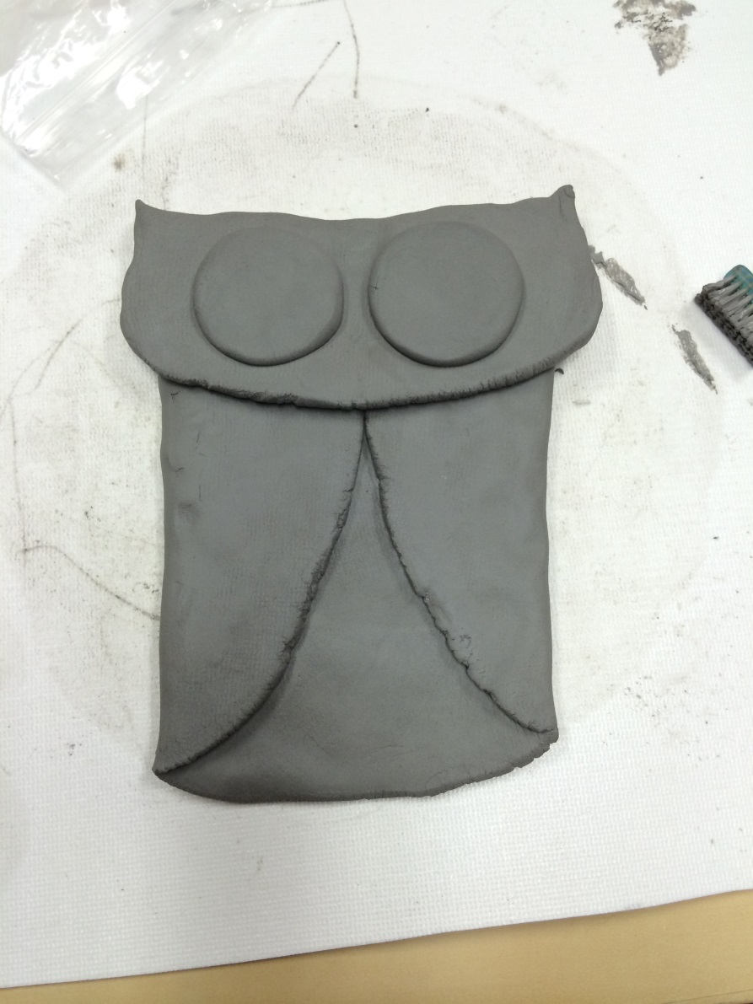
Place them on the head.

Slide 10
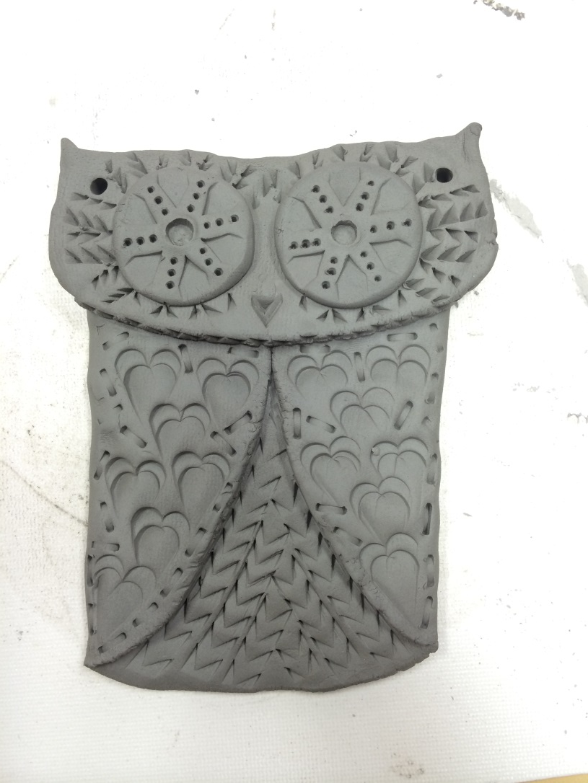
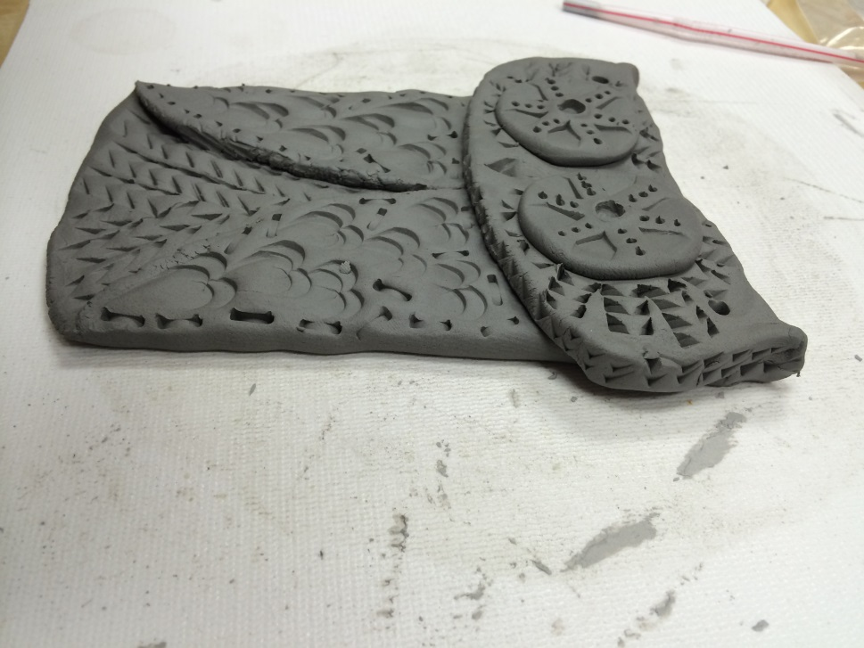
Now Create & Design!!!

Slide 11
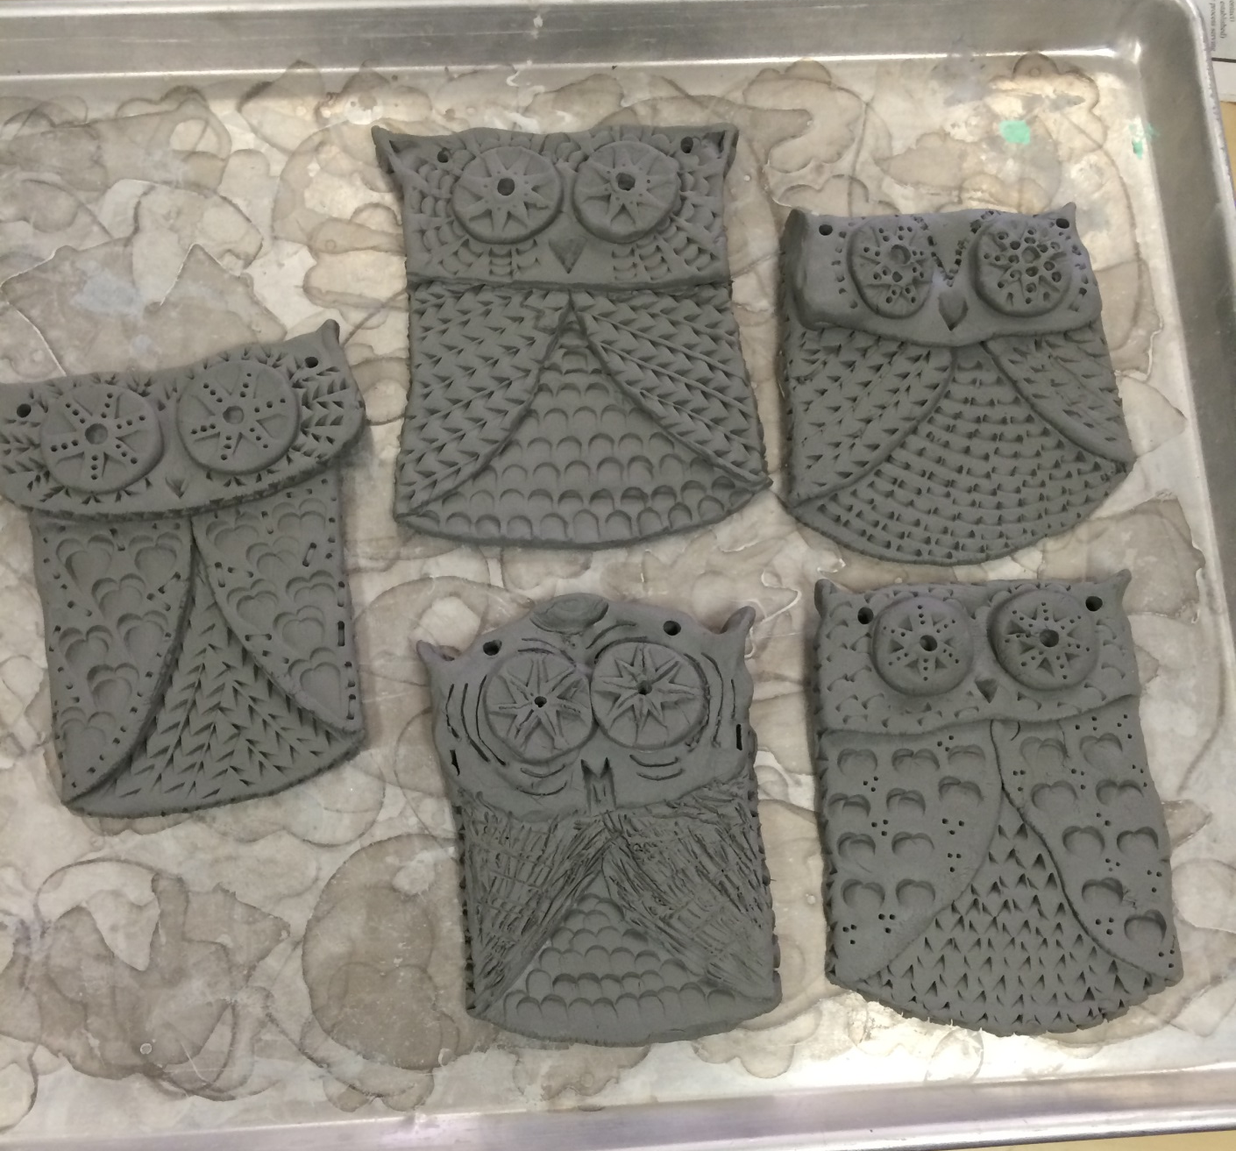
Owls!!!

Slide 12
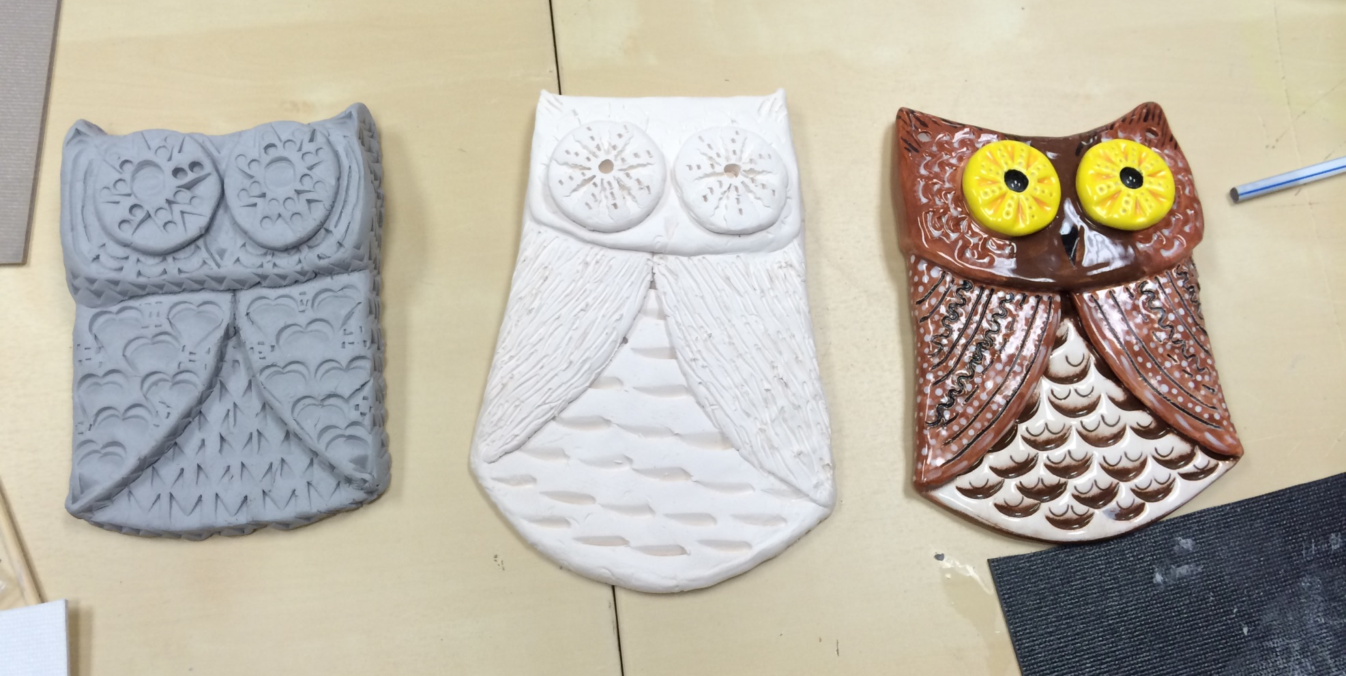
3 Stages to Completion…

Slide 13
THE END ☺

